Slide 1
Legal Issues
‘A Fair and Accurate Representation of the Scene’
Authentic
Relevant & Material
More Probative then Prejudicial

Slide 2
Legal Issues
‘A Fair and Accurate Representation of the Scene’
* Exposure
* Color Accuracy
* Distance Relationships
* Focus/ Depth of Field
* Size

Slide 3
Exposure
Normally gross overexposures and under exposures can cause an image to be inadmissible.
Unless the only appropriate exposure is an underexposure or overexposure.

Slide 4
Color Accuracy
* Capture the color correctly:
1. Midday sun
2. Electronic Flash
3. Use appropriate White Balance
* Ensure the proper colors are printed.

Slide 5
Color Accuracy

Slide 6
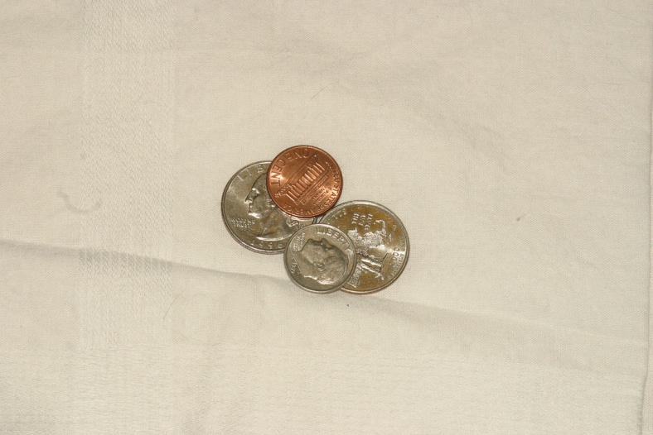
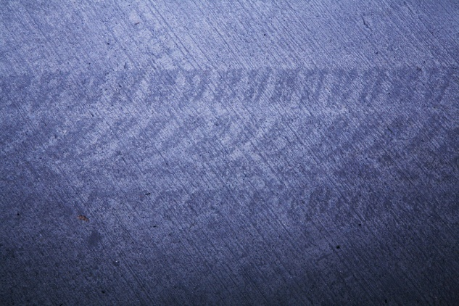
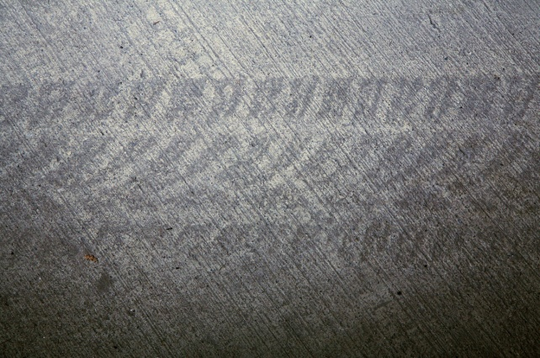
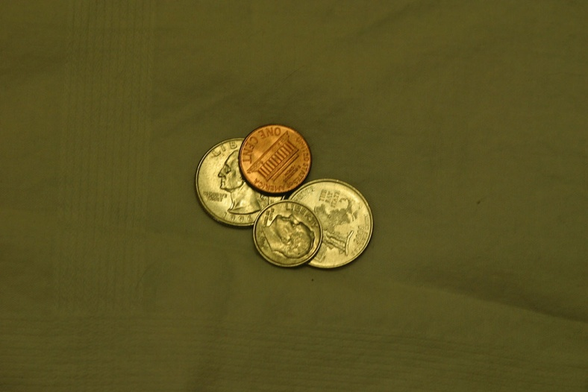
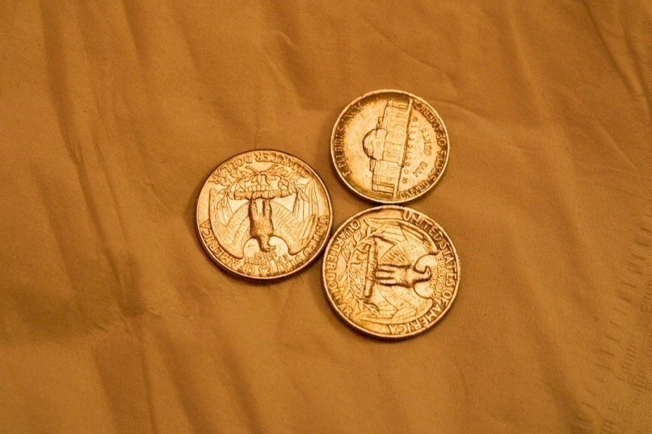
Color Accuracy

Slide 7
Color Accuracy

Slide 8
Color Accuracy

Slide 9
Color Accuracy

Slide 10
Distance Relationships

Slide 11
Distance Relationships

Slide 12
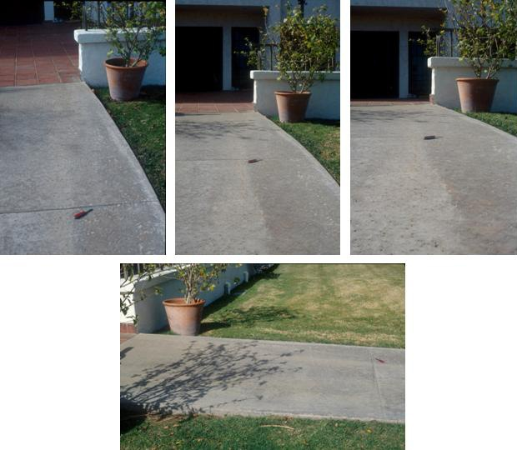
Distance Relationships

Slide 13
Focus/ Depth of Field
F/Stop selection
Focal Length
Camera to Subject Distance

Slide 14
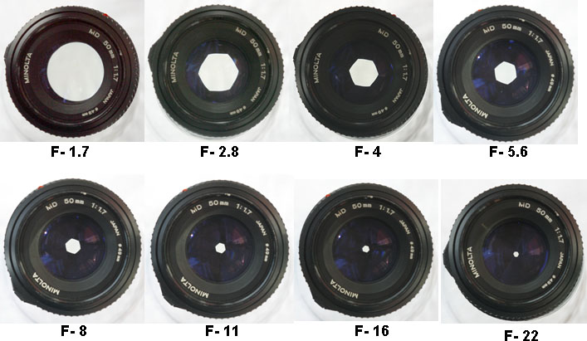
Focus/ Depth of Field

Slide 15
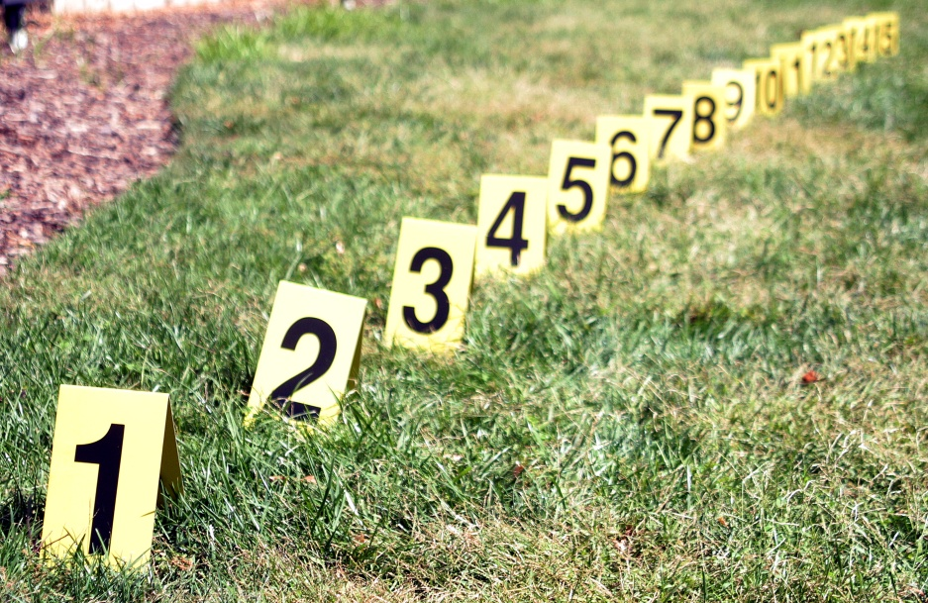
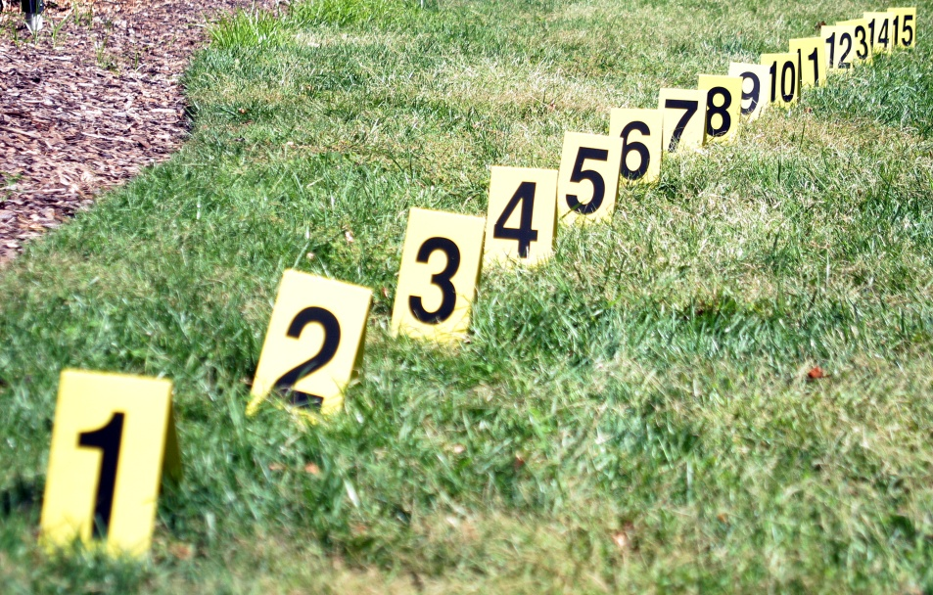
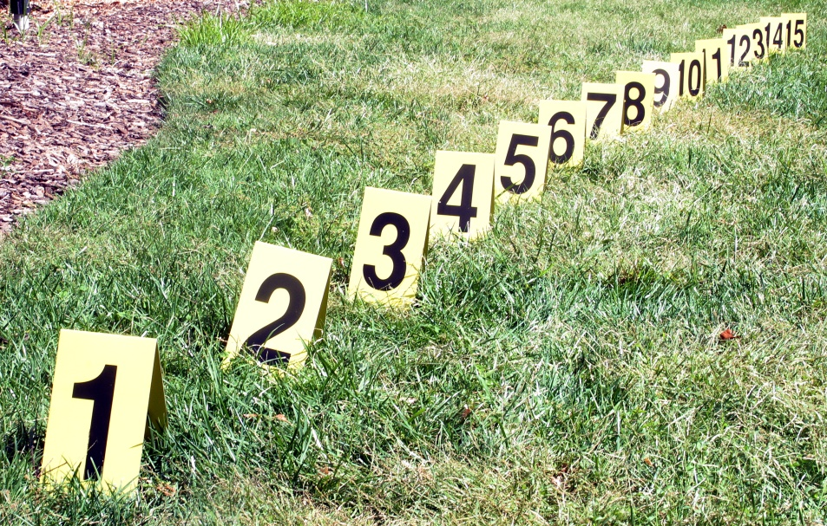
Focus/ Depth of Field

Slide 16
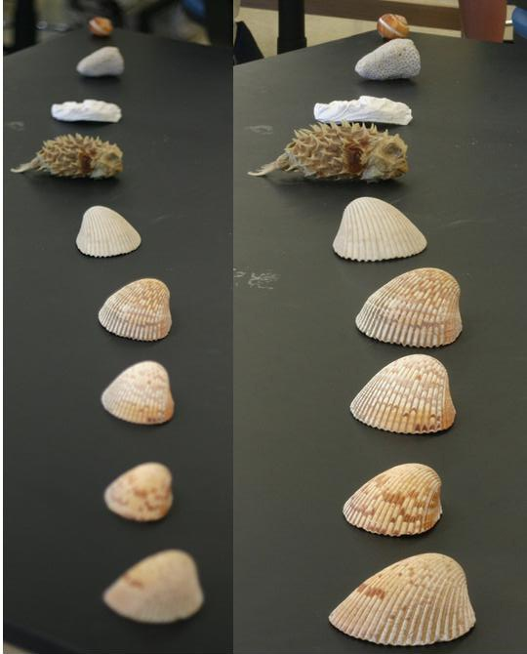
Focus/ Depth of Field

Slide 17
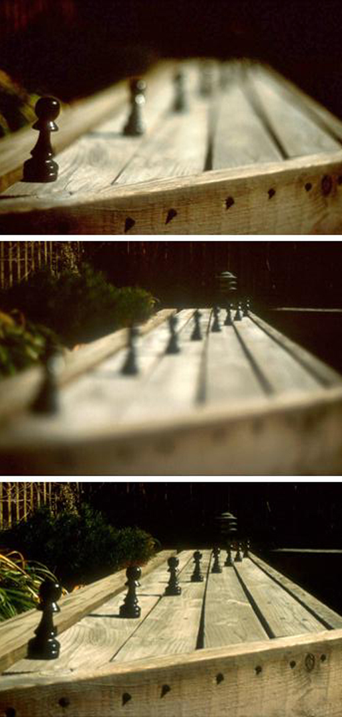
Focus/ Depth of Field

Slide 18
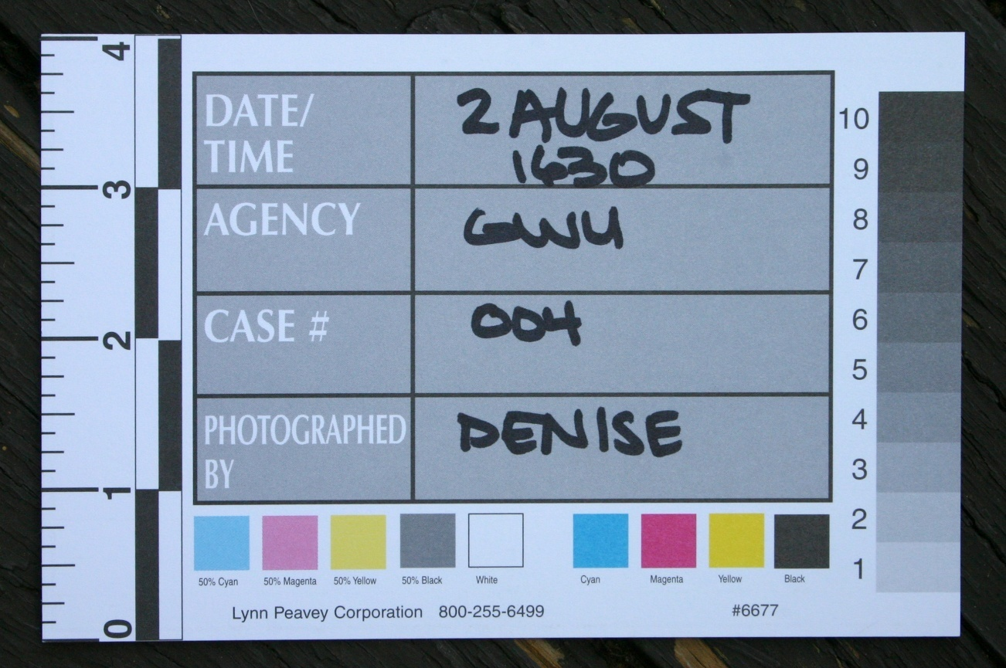
Size

Slide 19
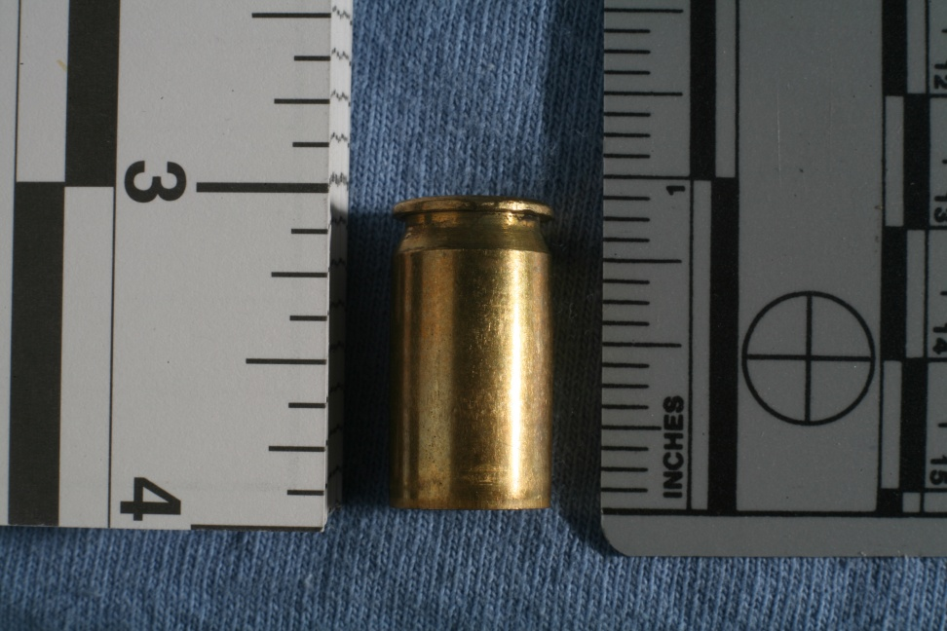
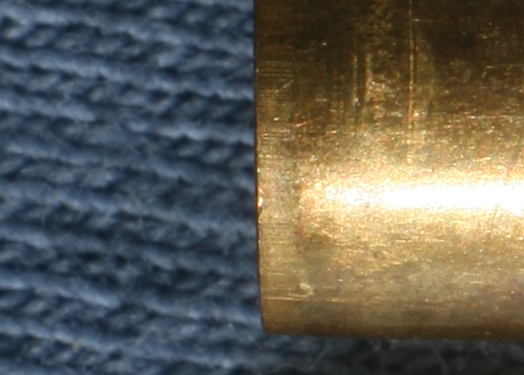
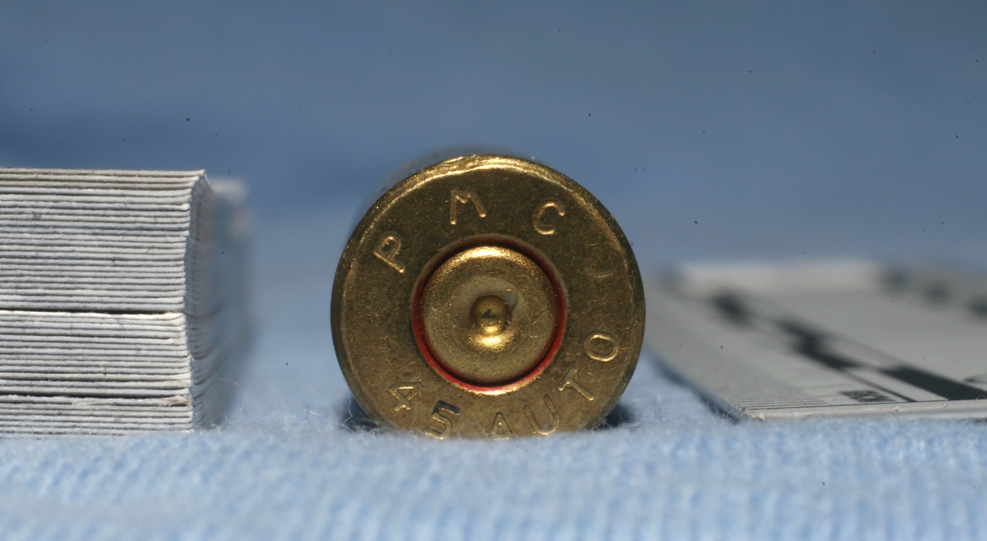
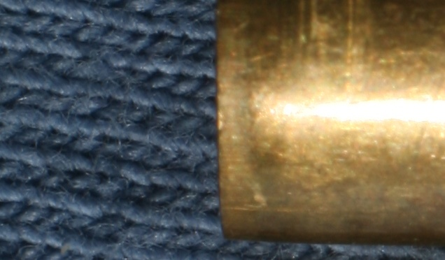
Size

Slide 20
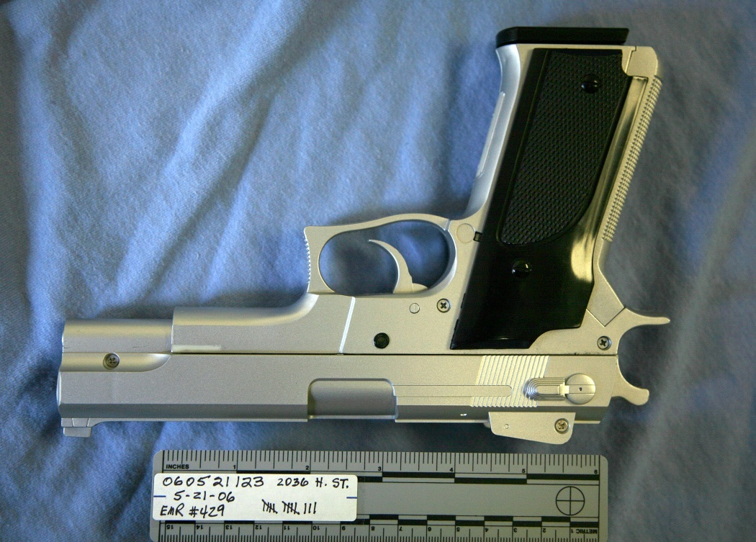
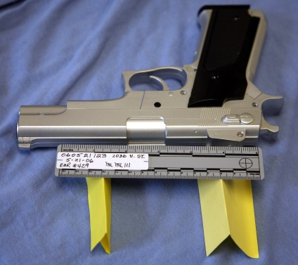
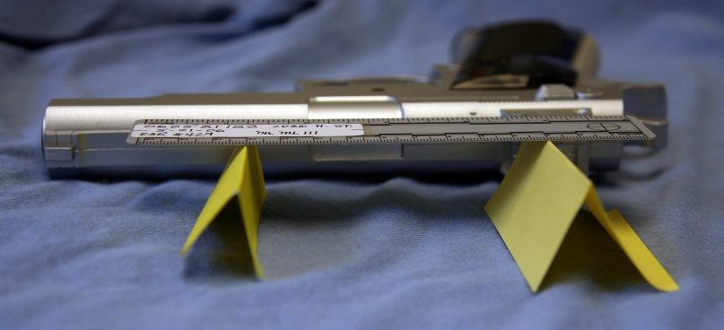
Size

Slide 21
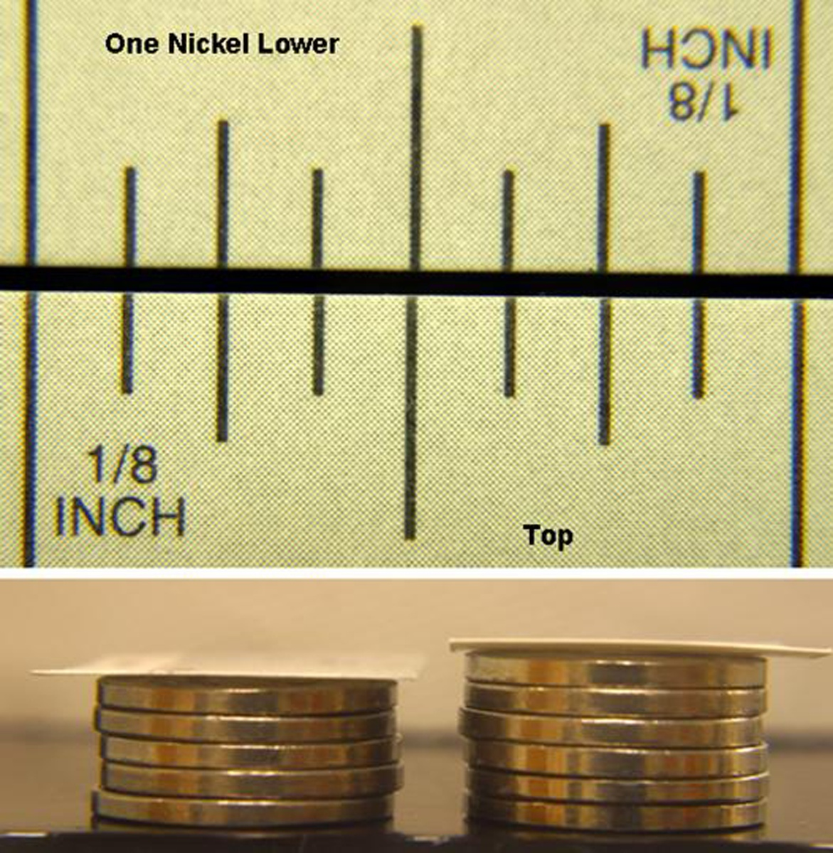
Size

Slide 22
Authentic
‘As Found,’ ‘As is’ or ‘in situ.’
Not a recreation or a simulation unless expressly indicated as such,

Slide 23
Relevant & Material
Pertains to a fact still in dispute.
Tending to prove or disprove a fact still at issue.

Slide 24
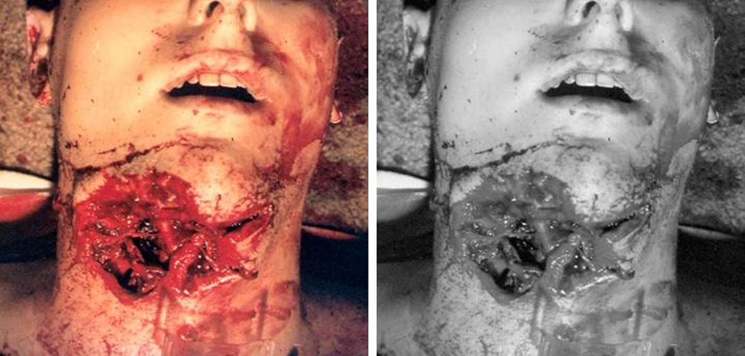
More Probative than Prejudicial

Slide 25
More Probative than Prejudicial

Slide 26
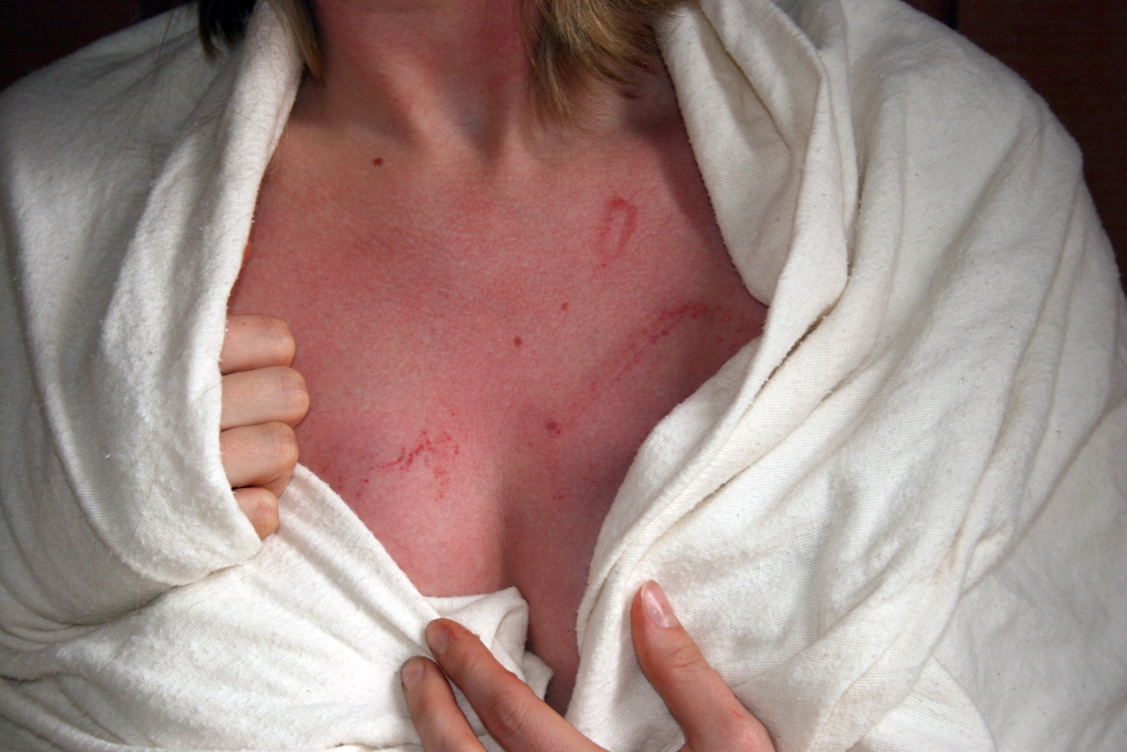
More Probative than Prejudicial

Slide 27
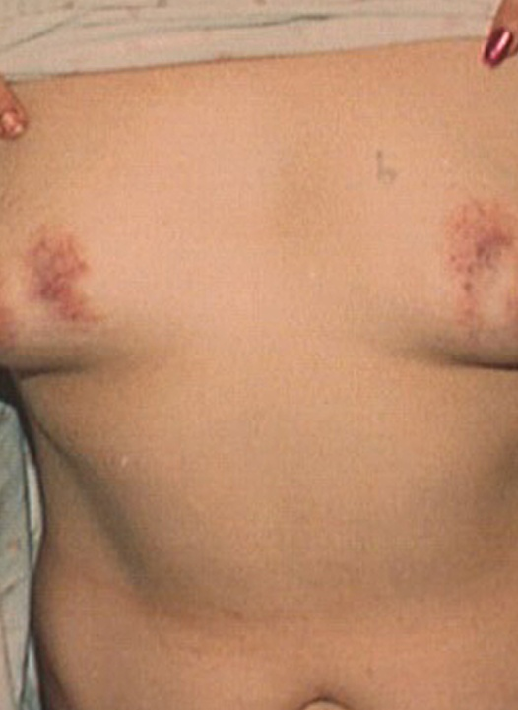
More Probative than Prejudicial

Slide 28
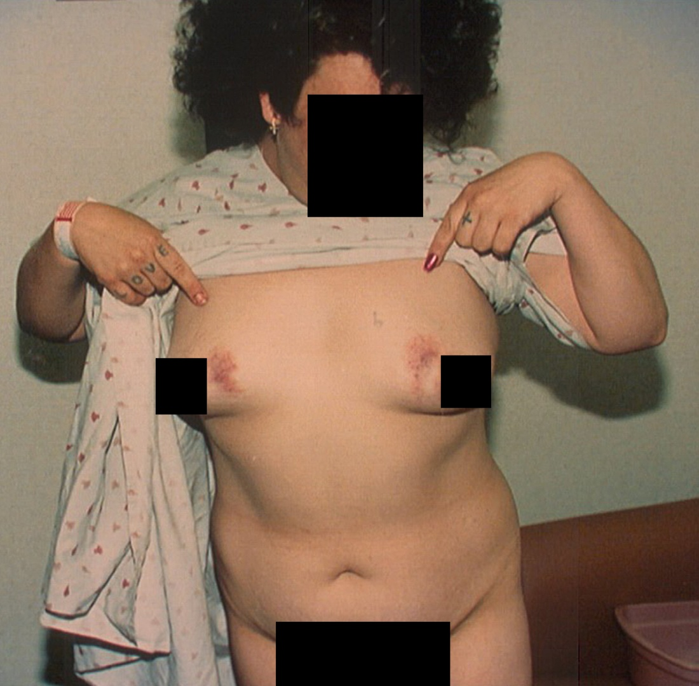
More Probative than Prejudicial

Slide 29
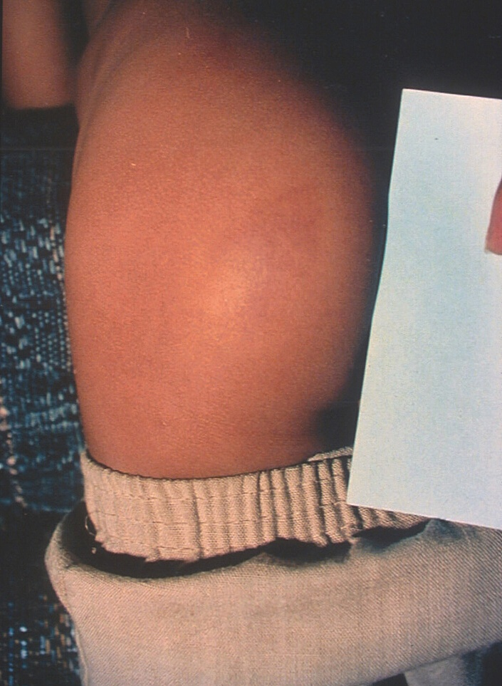
More Probative than Prejudicial

Slide 30
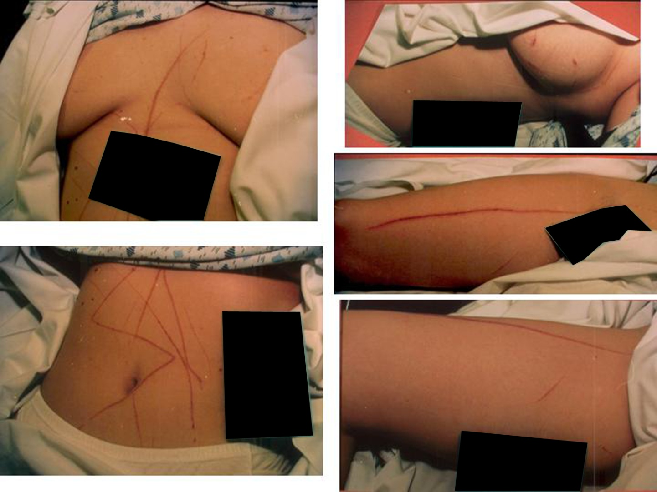
More Probative than Prejudicial

